Slide 1
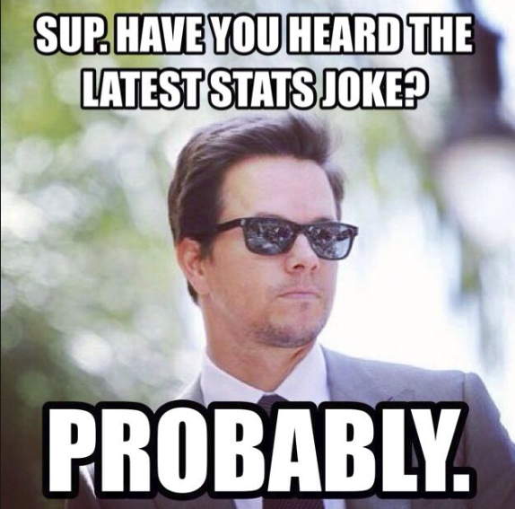
Statistics Analysing Data
Year 10 Mathematics

Slide 2
24
7
30
Topic: Statistics
Date: /06/2018
EQ – How do I assess data quality
There are 2 types of data collected
Primary Data – Collected by the investigator for a specific purpose
Secondary Data – Collected by someone else or for some other purpose
When collecting data it is essential to state the source of the data

Slide 3
24
7
30
Topic: Statistics
Date: /06/2018
EQ – How do I assess data quality
A fair sample is collected from a sample that is like the rest of the population. A biased sample is not typical of the population.
Biased methods and biased questions are likely to influence results in a particular direction. Fair ones are not likely to influence results in a particular way.
Fair questions with fair samples will not give reliable results if the sample is too small. A clear pattern in results of a good survey does suggest that a sample is sufficient. However, conclusions drawn from surveys where frequencies are less than 5 should be regarded with suspicion.

Slide 4
24
7
30
Topic: Statistics
Date: /06/2018
EQ – How do I assess data quality
A fair sample is collected from a sample that is like the rest of the population. A biased sample is not typical of the population.
Biased methods and biased questions are likely to influence results in a particular direction. Fair ones are not likely to influence results in a particular way.
Fair questions with fair samples will not give reliable results if the sample is too small. A clear pattern in results of a good survey does suggest that a sample is sufficient. However, conclusions drawn from surveys where frequencies are less than 5 should be regarded with suspicion.
Non-compliant data is obviously wrong, like someone’s age being 164.
Outliers are data items that are a long way from the rest of the data, but that could be correct.

Slide 5
24
7
30
Topic: Statistics
Date: /06/2018
EQ – How do I assess data quality
If data is collected in a biased way, contains many non-compliant items or lots of outliers, or is collected using very small samples, then it is likely to be of poor quality.
A survey of shoppers about their holiday plans is conducted as a competition. Survey forms are left in fast food outlets and prizes go to the first 3 names drawn. Respondents are asked questions about their income, family, desired holiday destinations and the kinds of holidays they prefer. They complete the forms by filling in their name, phone number, email and address and put them in boxes at the shops.
Discuss with a partner why this is likely to give poor quality data.

Slide 6
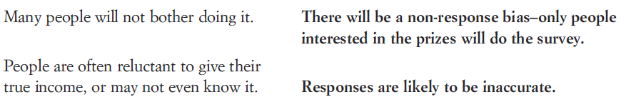
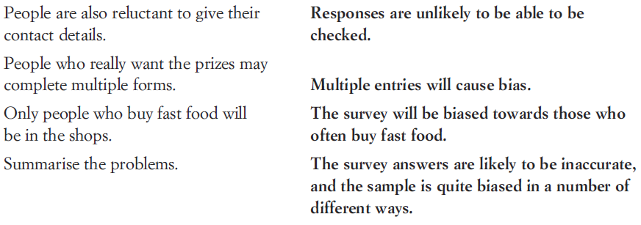
24
7
30
Topic: Statistics
Date: /06/2018
EQ – How do I assess data quality
A survey of shoppers about their holiday plans is conducted as a competition. Survey forms are left in fast food outlets and prizes go to the first 3 names drawn. Respondents are asked questions about their income, family, desired holiday destinations and the kinds of holidays they prefer. They complete the forms by filling in their name, phone number, email and address and put them in boxes at the shops.

Slide 7
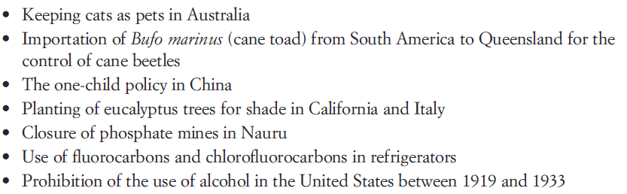
24
7
30
Topic: Statistics
Date: /06/2018
EQ – How do I assess data quality
In the last lesson we saw that misunderstood statistics could lead to unintended consequences, e.g. prevent shark attacks by banning ice cream sales.
Working in groups of 3-4 consider what the unintended consequences for these actions could be / have been

